Slide 1
Handling Missing Values in Data Analysis

Slide 2
What are Missing Values?
Missing values occur when no data is available for a specific observation in a dataset. Missing data can lead to inaccurate analysis and biased models if not handled properly.
Examples:
In a survey, if a respondent doesn’t answer a question.
A sensor malfunctioning during data collection.

Slide 3
Why Do Missing Values Occur?
Common Causes of Missing Data:
Human error : Data entry mistakes.
Equipment failure: Sensors malfunctioning.
Intentional : Some data might be skipped deliberately (e.g., privacy concerns).
Data corruption : During transmission or storage.

Slide 4
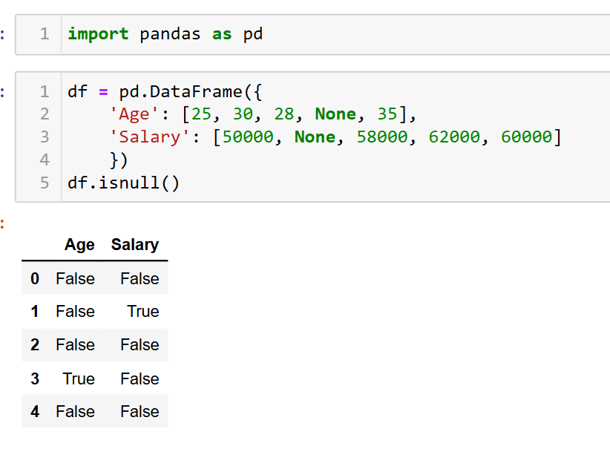
Identifying Missing Values
Types of Missing Data:
MCAR (Missing Completely at Random): Data missing with no pattern or reason.
MAR (Missing at Random): Missing values depend on other observed variables.
MNAR (Missing Not at Random): Missing values depend on unobserved factors.

Slide 5
Simple Strategies to Handle Missing Data

Slide 6
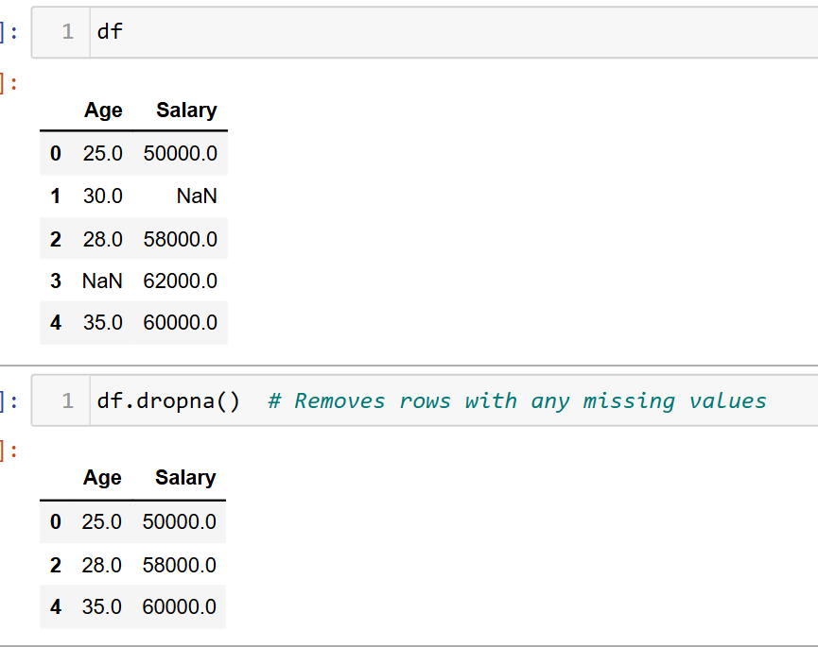
1. Remove Data (Deletion):
Listwise deletion: Remove rows with missing data.
Pairwise deletion: Use available data without removing entire rows.
When to use :
When you have small percentage of missing data (<5%).

Slide 7
2. Imputation
Replace missing values with the mean, median, or mode of the column.
Mean Imputation
This method replaces missing values with the mean of the column. It's useful when the data is symmetrically distributed.
Median Imputation
For skewed data, using the median is more appropriate.
Mode Imputation (Most Frequent)
Missing categorical values are replaced with the most frequent (mode) value.

Slide 8
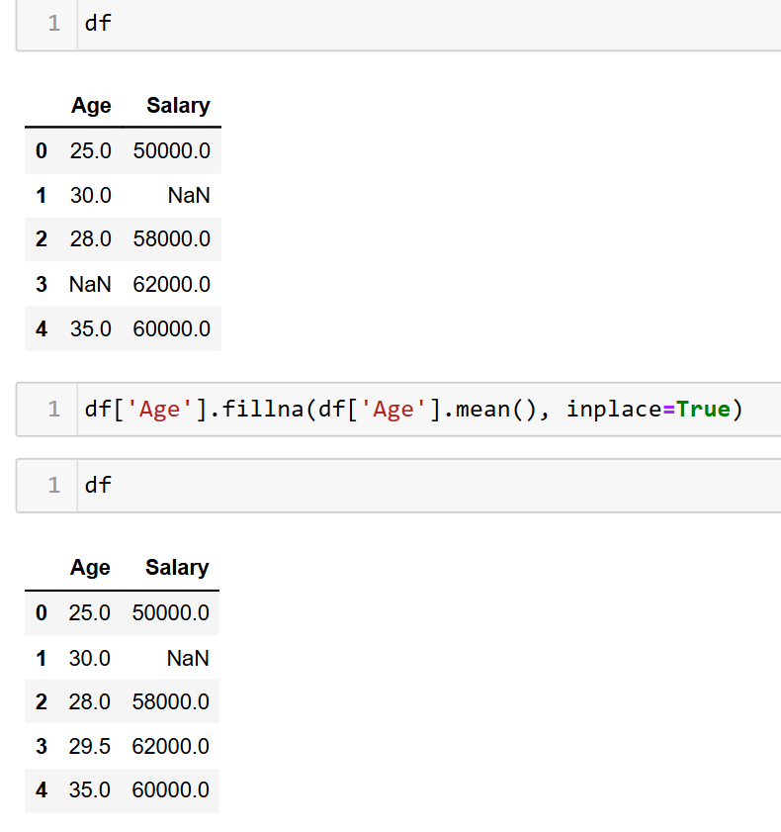
Example

Slide 9
Advanced Imputation Methods

Slide 10
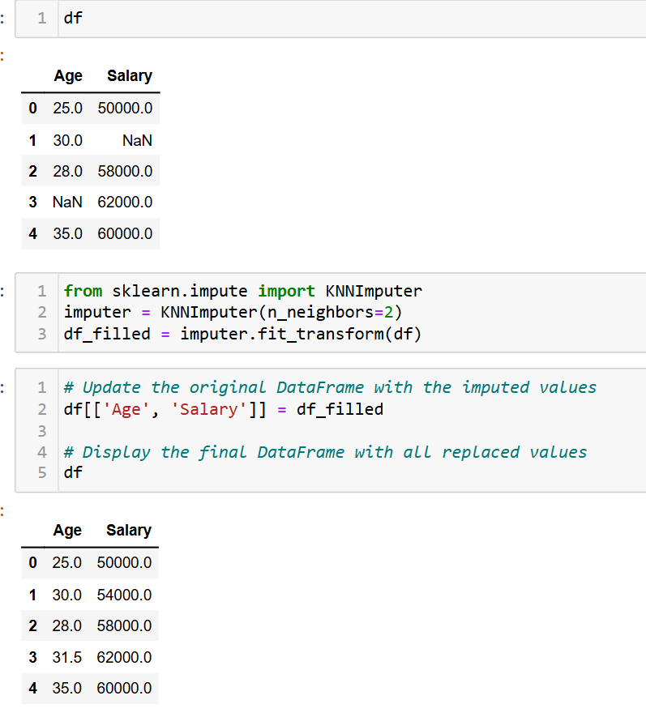
K-Nearest Neighbors (KNN)
Finds the k closest data points (neighbors) and uses their values to estimate the missing one.

Slide 11
Regression Imputation
Regression imputation means predicting missing values by treating it as a regression problem.
To predict missing values using a regression model, we can train a regression model (like Linear Regression) on the non-missing data and use it to predict the missing values.

Slide 12
Handling Categorical Missing Data

Slide 13
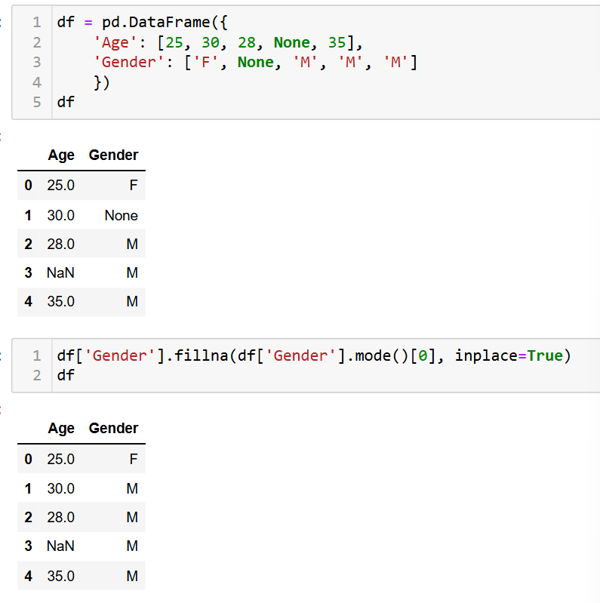
Mode Imputation:
Replace missing categories with the most frequent category.

Slide 14
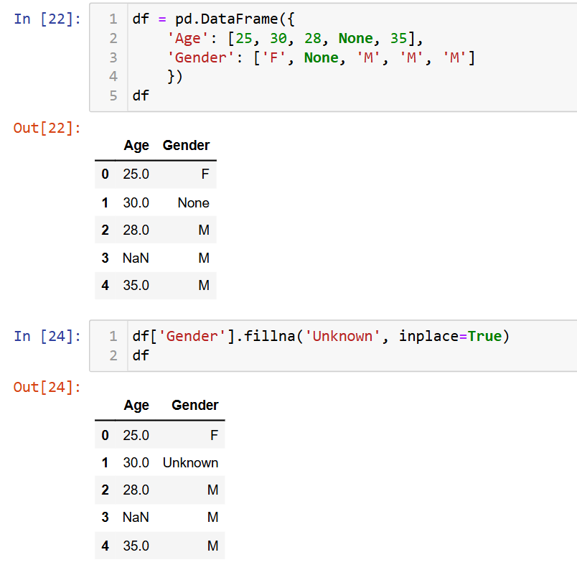
Create a “Unknown" Category:
Introduce a new category called “Unknown."
Sometimes, it’s better to create a new category for missing values, especially if they might have significance.

Slide 15
When to Use Which Method?
Deletion
When you have very few missing values. missing one.
Mean/Median Imputation
Suitable when data is missing at random and the variable is normally distributed.
KNN Imputation
For datasets with many correlated variables.
Regression Imputation
When you have a lot of related features to predict the missing one.

Slide 16
Explanation with an Example

Slide 17
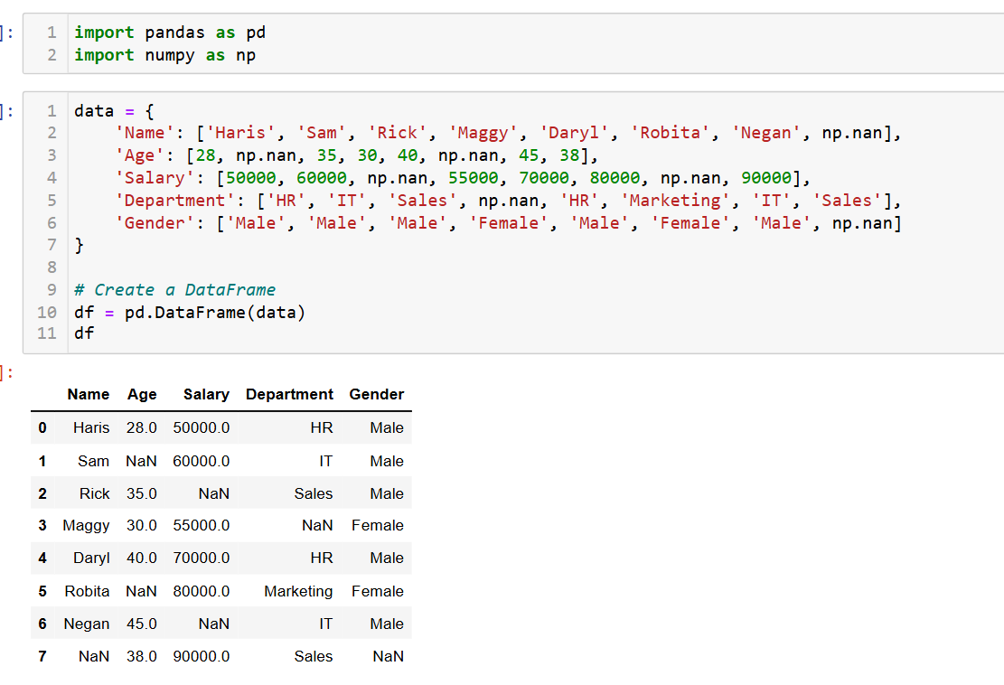
Load and Inspect the Dataset

Slide 18
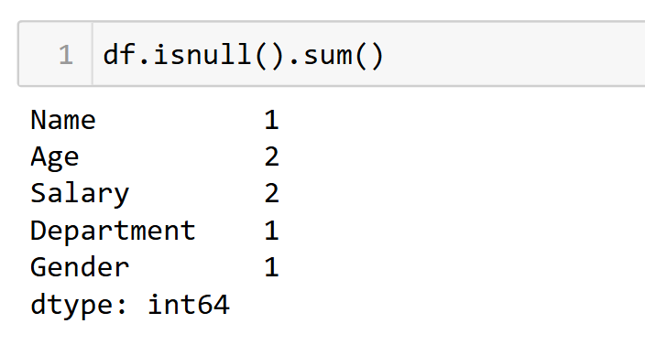
Check for missing values

Slide 19
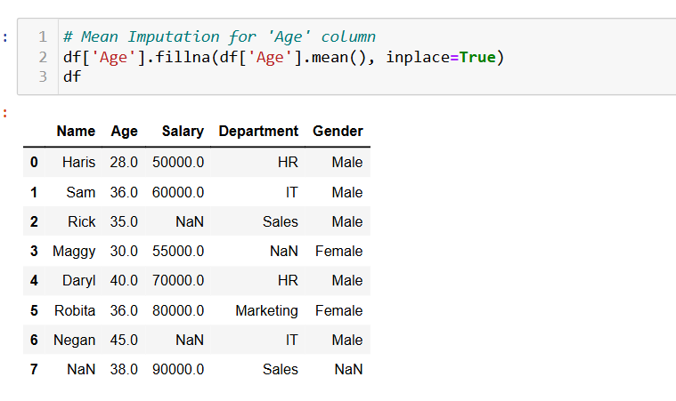
Handling Missing Numerical Data
The missing values in the Age column are replaced with the mean of the other values.

Slide 20
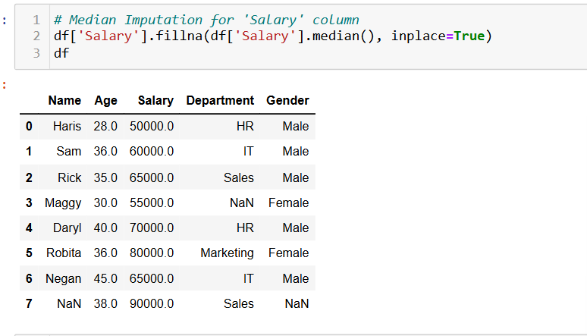
Handling Missing Numerical Data
The median value of the Salary column is used to replace the missing values.

Slide 21
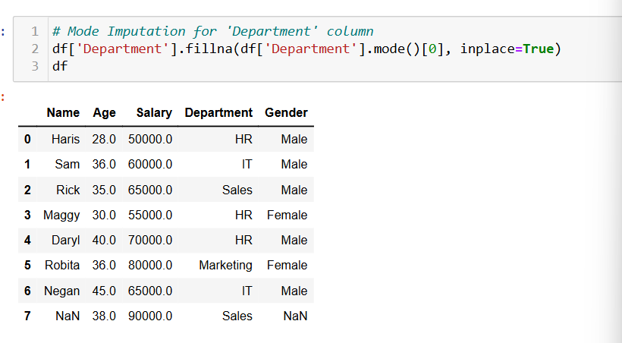
Handling Missing Categorical Data
In the Department column, the missing value is replaced with "HR," which is the most frequent category.

Slide 22
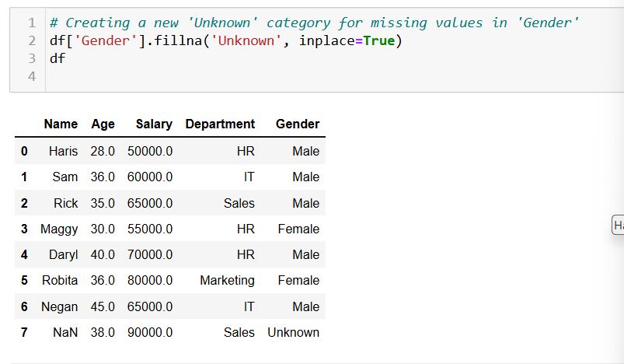
Handling Missing Categorical Data
We introduce a new "Unknown" category in the Gender column to signify that the data is missing.

Slide 23
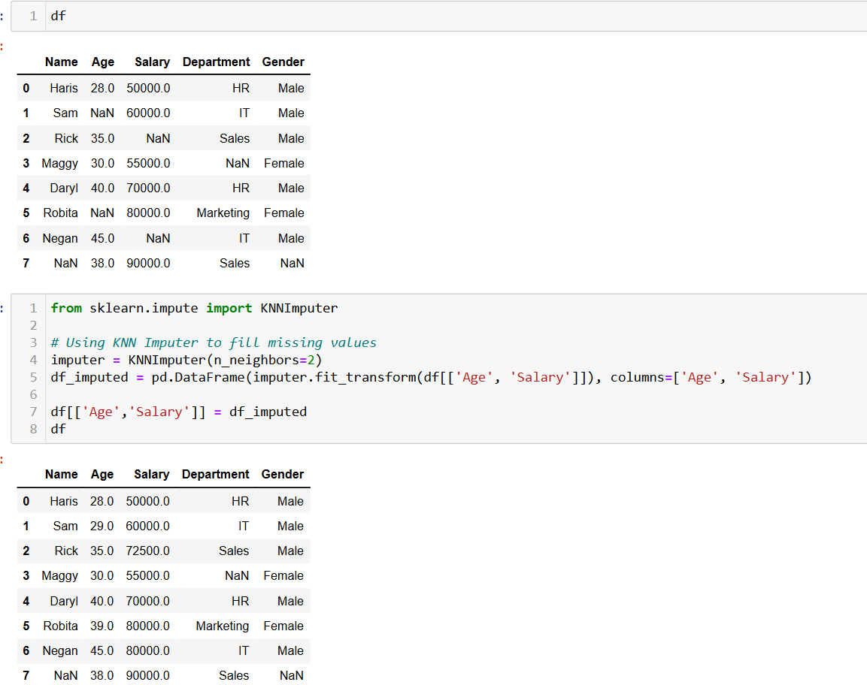
Advanced Imputation Techniques (KNN imputation)
KNN uses the values of the nearest neighbors to predict the missing values, making it more accurate for complex datasets.

Slide 24
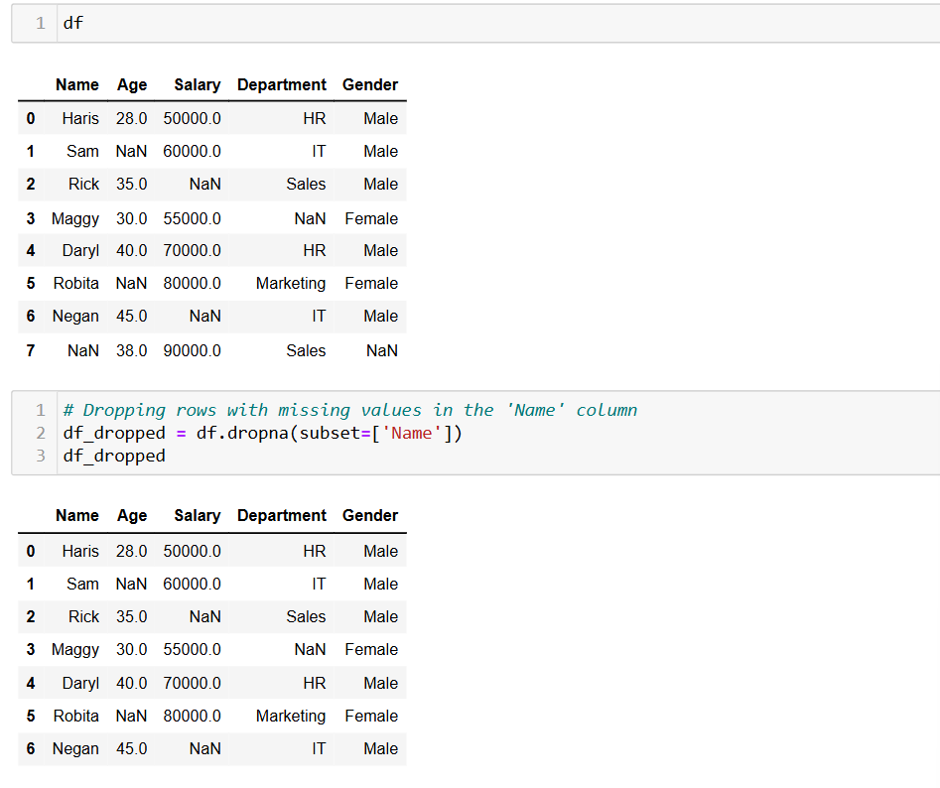
Removing Rows with Missing Values
This approach is used when missing values are rare or when their removal won’t impact the analysis.

Slide 25
Using a Regression Model to Predict Missing Values

Slide 26
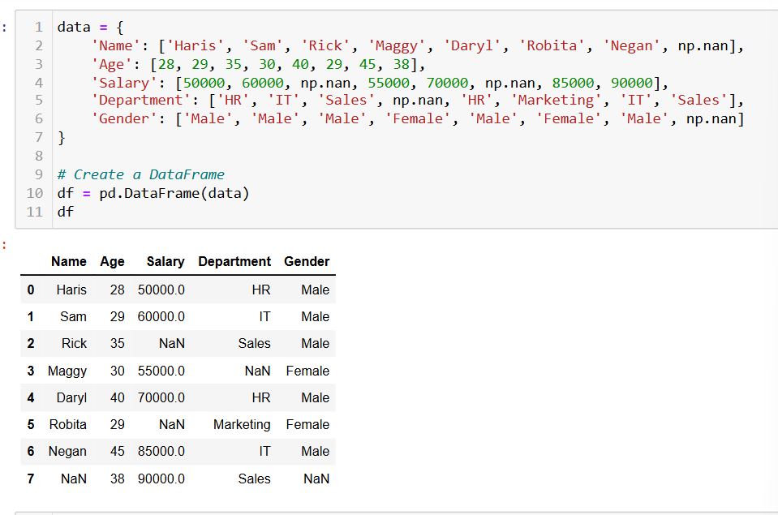
Loading and checking the data

Slide 27
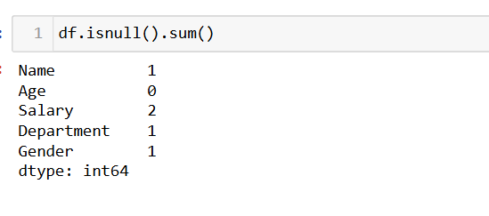
Checking for null values

Slide 28
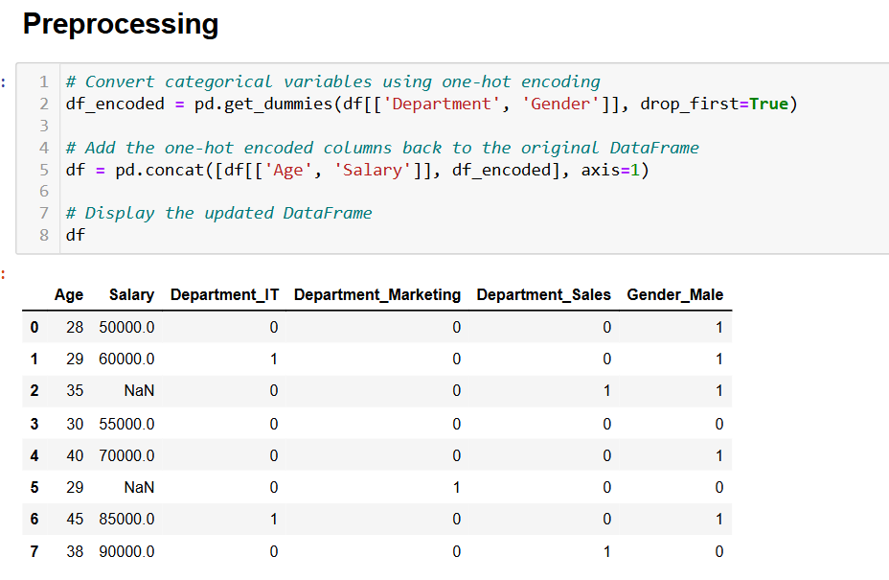
Preprocessing the Data
Since regression models only work with numerical data, you will need to convert categorical columns (like Department and Gender) into numerical values using label encoding or one-hot encoding.
This will convert the categorical columns into numerical columns that can be used for regression.

Slide 29
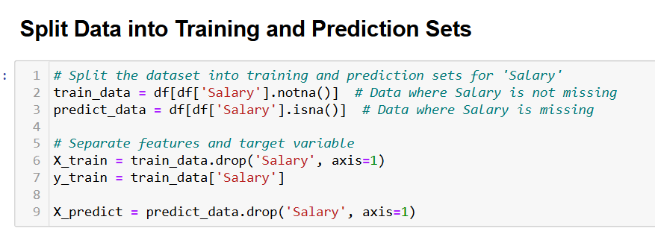
Split Data into Training and Prediction Sets
We will now split the data into two sets:
Training Data : Rows without missing values.
Prediction Data: Rows with missing values (to be predicted).
We’ll predict missing values for the Salary column using a regression model.

Slide 30
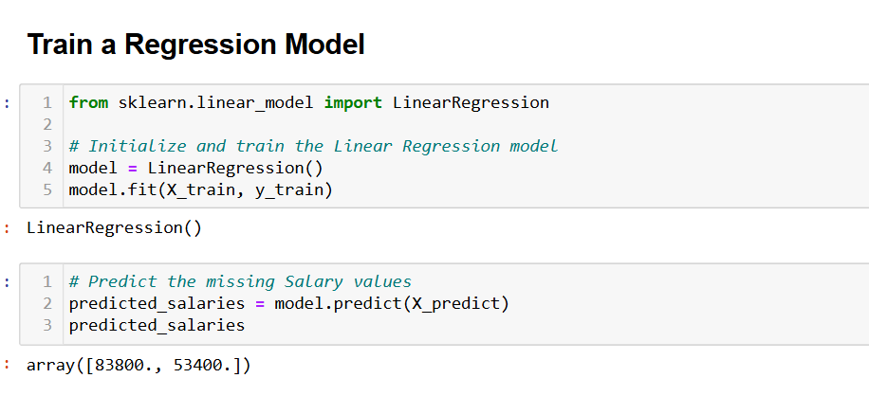
Train a Regression Model and predicting the values
We’ll use a Linear Regression model to predict the missing Salary values based on the other features.
The LinearRegression model is trained on the rows where Salary is not missing.
We then use this trained model to predict the missing Salary values based on other features (such as Age, Department, Gender).

Slide 31
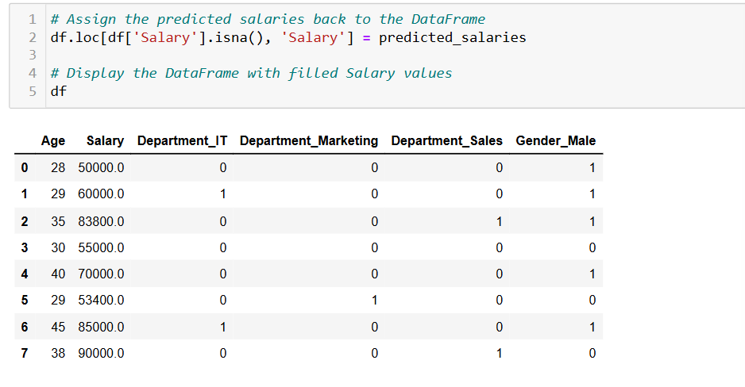
Assigning the predicted salaries to DataFrame

Slide 32
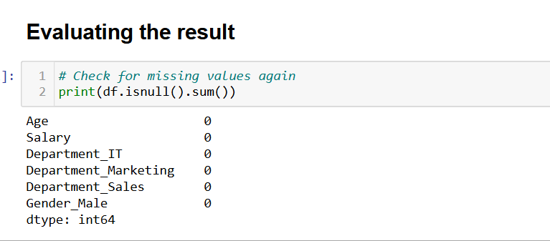
Evaluate the Results
Now that we’ve predicted the missing values for Salary, the DataFrame will have no missing values in the Salary column.

Slide 33
Thank You

